Slide 1
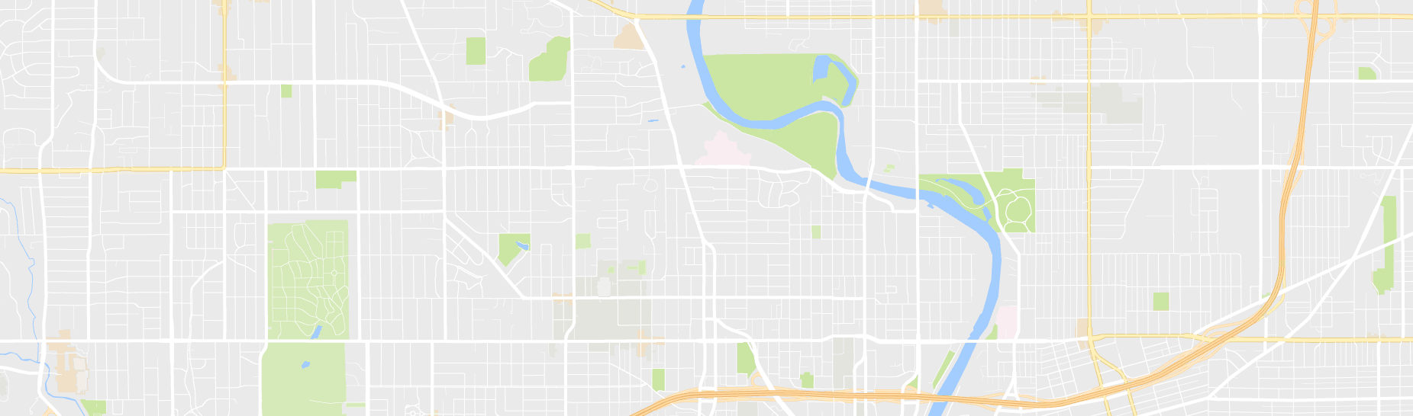



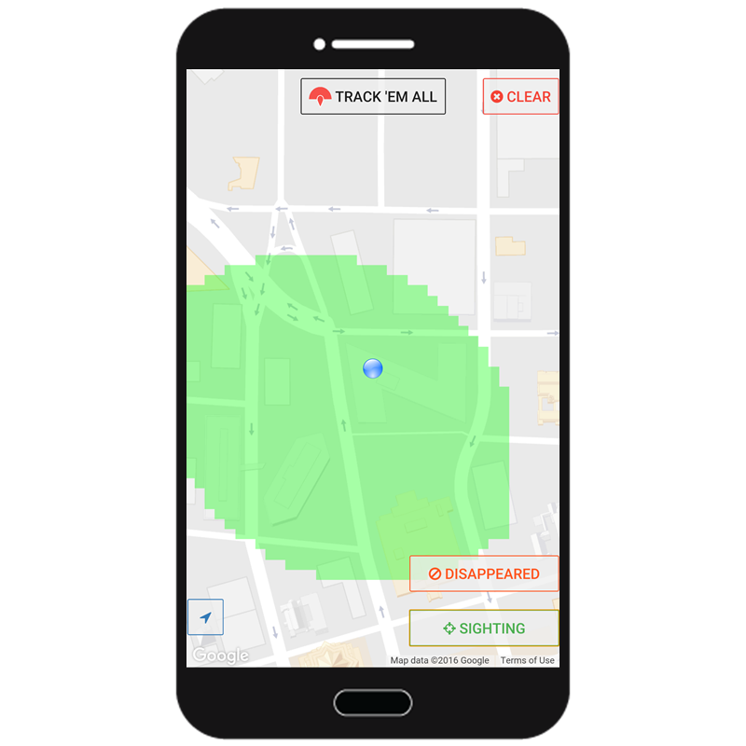
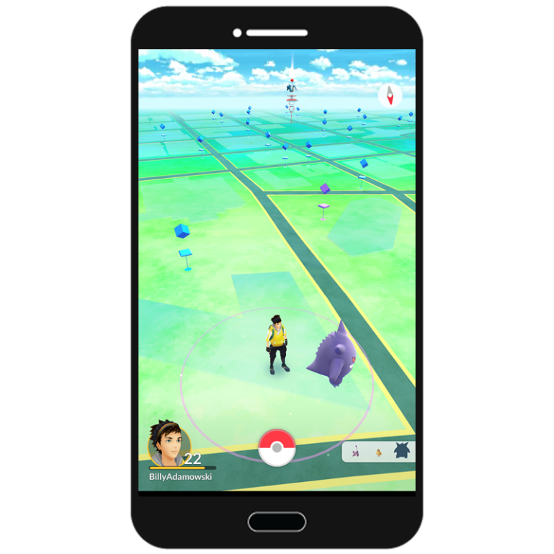
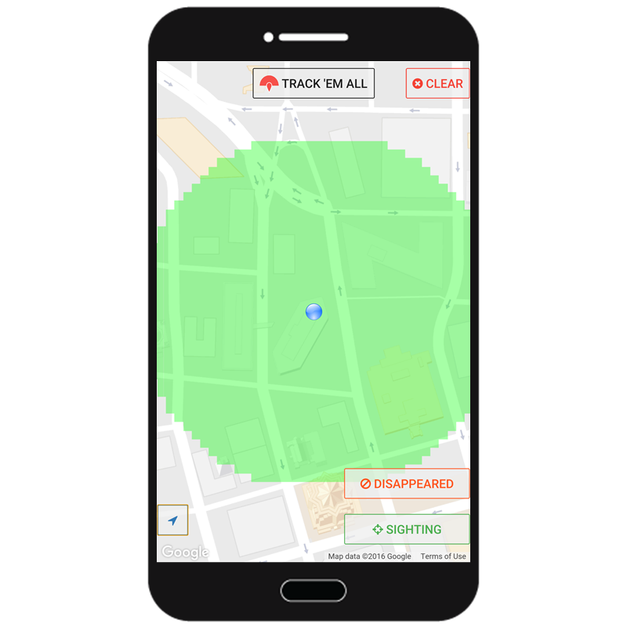
A wild Gengar appeared in the Sightings! Let’s use
Track 'Em All to find him!
Record Sighting and Disappeared points, the green area is where the wild Gengar will be.

